Slide 1
Absolutism and the Emergence of Great Britain (England)
How were European rulers guided by enlightenment thought?
Give examples (explain) of how Absolute monarchs succeeded and failed in their quests to implement enlightenment ideas in Europe.

Slide 2
Absolutism A. How were European rulers guided by enlightenment thought?
By the mid 18th century, many monarchs in Europe saw the rise in popularity of natural rights and freedoms preached by the philosophes.
This led to a new type of monarch, and government known as enlightened absolutism.
Three major states, Austria, Prussia, and Russia all sought to follow these new ideas while still maintaining their absolute control.

Slide 3
Absolutism A. How were European rulers guided by enlightenment thought?
As the monarchs of these nations attempted to create religious freedom, freedom of speech, decrease in torture methods, increased education of serfs (lower class), etc., three major problems existed:
1. Nobles became upset because the serfs and peasants were granted more power.
2. The Catholic Church became upset because of the allowance of religious tolerance.
3. Peasants began to revolt because they didn’t understand why so many drastic changes were happening so quickly.

Slide 4
Absolutism A. How were European rulers guided by enlightenment thought?
Read the section Enlightenment and Absolutism on p. 140 -142 in your textbook and answer the following questions:
1. Give examples of how Catherine did not embrace enlightened ideas and why. What was the outcome?
2. Give examples of how all 3 enlightened monarchs discussed did embrace enlightened ideas.
3. Give one example of how Joseph and Frederick fulfilled or failed to fulfill the idea of enlightened absolutism. Describe the outcome of that particular ruler (be specific).

Slide 5
The Seven Year’s War
C. Explain how conflict in Europe leads to completion and desire to control overseas territories in India and Europe.
D. How did the Seven Year’s War allow Great Britain to become the World’s greatest colonial power?

Slide 6
The Seven Year’s War and the Rise of Great Britain C. Explain how conflict in Europe leads to completion and desire to control overseas territories in India and Europe.
In 1740, Charles VI of Austria dies. Among confusion of succession, his daughter Maria Theresa succeeded him.
Sensing the confusion and refusing to acknowledge a woman as monarch, Frederick II of Prussia invades part of Austria (Silesia).
France allied with Prussia and Great Britain allied with Austria – The War of Austrian Succession (1740 – 1748)
In 1748, a peace agreement was signed and all former territories were returned except for Silesia.

Slide 7
After the War of Austrian Succession Seven Year’s War – (1754 – 1763)
In 1756, the allies switched. The British allied with Prussia and France allied with Austria, and also formed a new alliance with Russia.
Fighting occurred in Europe, the Americas, and India.
By 1763, the war in Europe had ended with Austria recognizing Prussia’s control over their former territory of Silesia.
During the same time, the war between Britain and France intensified.
By 1763 (Treaty of Paris), Britain had gained complete control of India from France.

Slide 8
Daily Assignment
Who allied with who?
The War of Austrian Succession ultimately led to a war between which two European powers?

Slide 9
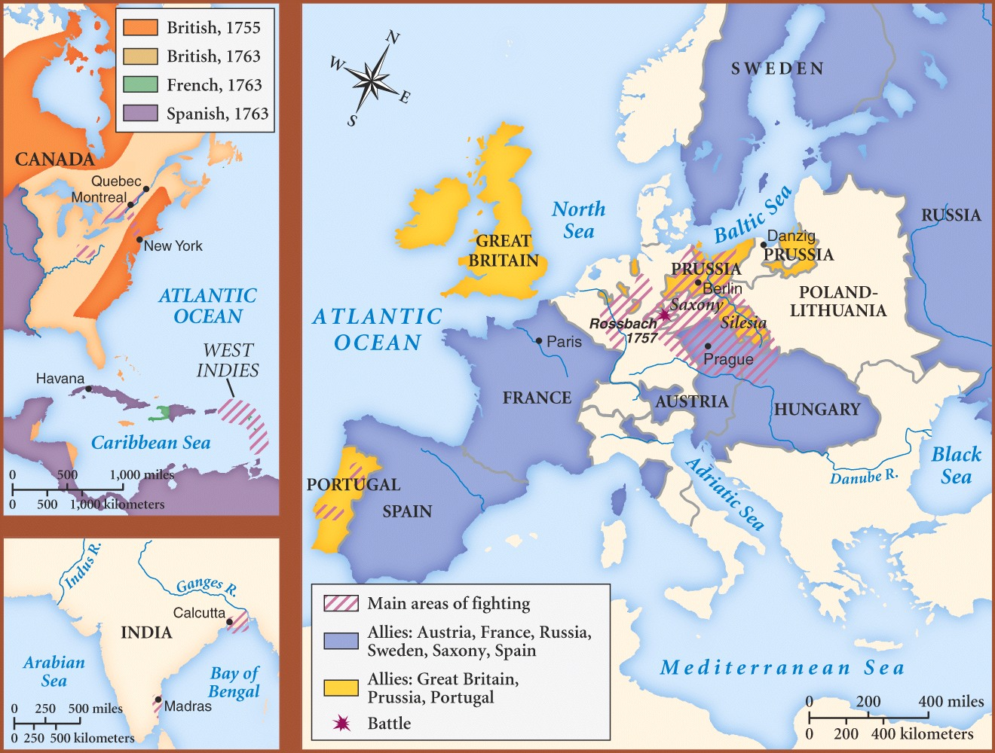

Slide 10
Seven Year’s War in the Americas B. How did the Seven Year’s War allow Great Britain to become the World’s greatest colonial power?
By 1750, France controlled most of Southern Canada and a bulk of present day United States (minus the east coast and Florida). This land was used for fur, fish, and timber.
The British were prospering in their 13 colonies, which had a population around one million people. However, the British felt they could not form a complete colonial empire in the Americas without destroying the French.
The two sides fought over the St. Lawrence seaway and the unsettled Ohio Valley (French and Indian War which is part of the Seven Years War).

Slide 11
Seven Year’s War in the Americas B. How did the Seven Year’s War allow Great Britain to become the World’s greatest colonial power?
By 1759, the British had established the upper hand on the French in the Americas when they seized Montreal (St. Lawrence Seaway), and the area around the Great Lakes.
In 1763, the French were forced to make peace.
The Treaty of Paris (1763) – The French transferred Canada and the lands east of the Mississippi to the English. Spain, an ally of France, also transferred control of Florida to England. In exchange, the French gave part of their Louisiana territory to the Spanish.

Slide 12
