Slide 1
Fascism in Italy
State Standard W.44: Trace Mussolini’s rise to power in Italy and his creation of a fascist state through the use of state terror and propaganda.
D. How did Mussolini create a dictatorial state in Italy?

Slide 2
D. How did Mussolini create a dictatorial state in Italy?
By 1919, Benito Mussolini had begun lobbying for a fascist state in Italy.
Fascism: political philosophy that glorifies state above individual and emphasizes a strong central government led by a dictator.
By 1922, Mussolini started to arouse the people’s interest in the lack of land Italy received after WWI. He knew that creating a strong sense of nationalism would lead more to join the fascist movement.
Mussolini used his new following to threaten the king (Victor Emmanuel III) with an attack on Rome if they were not given power.

Slide 3
D. How did Mussolini create a dictatorial state in Italy?
In response, King Victor Emmanuel III gave in and named Mussolini prime minister of Italy, giving him power to make laws.
By 1926, Mussolini had created laws to outlaw all other political parties in Italy.
Mussolini’s new police, the OVRA, were responsible for finding and jailing such citizens.
By the end of the year, Mussolini ruled Italy as the sole dictator, or II Duce (The Leader).

Slide 4
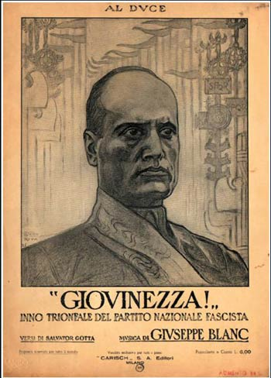
D. How did Mussolini create a dictatorial state in Italy?
Mussolini soon took control of mass media, using propaganda to convert more Italians to fascism.
“Mussolini is Always Right”
By 1939, 66% of the population between
the ages of 8-18 were part of Fascist
youth groups.

Slide 5
D. How did Mussolini create a dictatorial state in Italy?
Although Mussolini created a disciplined, war loving population, he never took totalitarian control of Italy as Hitler and Stalin did.
Most of Italy’s traditional social values were kept intact.
Women were still viewed as the pillar of the of the family and the family as the pillar of the state.
Unlike Stalin, Mussolini kept Christian values intact.
In 1929, 109 acres were granted to the Catholic Church for the establishment of Vatican City within Rome.
Mussolini recognized Catholicism as the “sole religion of the state”
In return, the Catholic Church urged Italians to support the Fascist regime.

