Slide 1
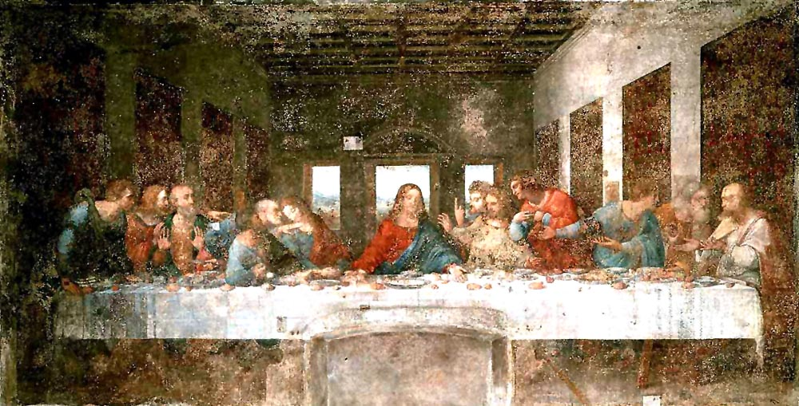
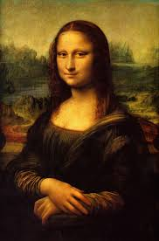
WORKS OF DA VINCI
MONA LISA -1503
TO 1517
LAST SUPPER - 1494 TO 1498

Slide 2
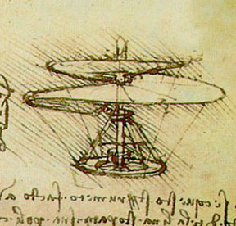
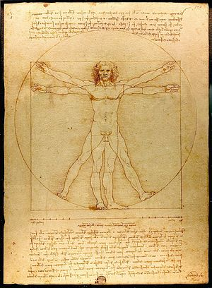
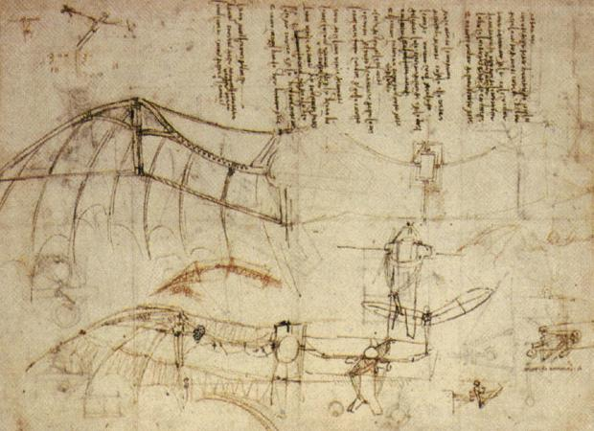
WORKS OF DA VINCI CONT.
AREAL SCREW
AND
“BAT WING”
VITRUVIAN MAN -1490

Slide 3
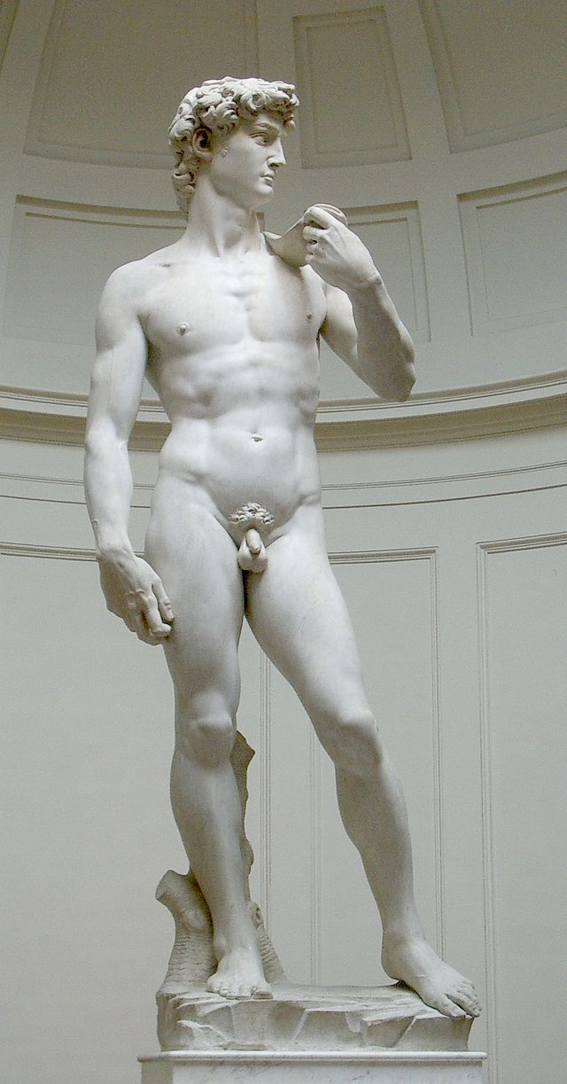
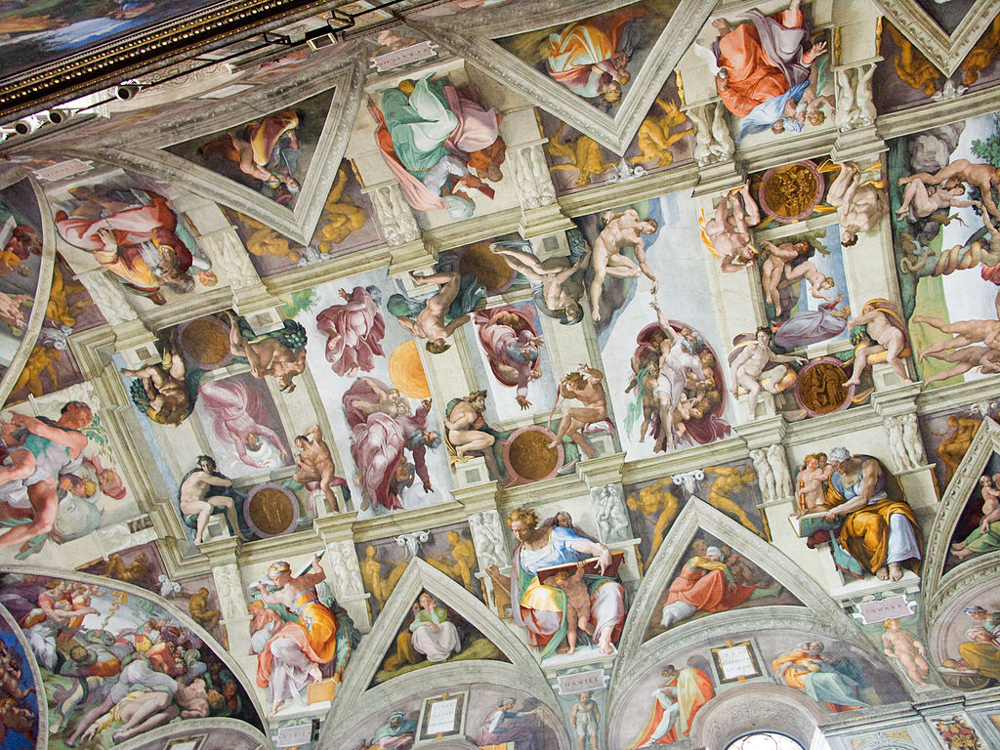
WORKS OF MICHAELANGELO
CEILING OF SISTINE CHAPEL
1505 - 1512
STATUE OF DAVID - 1504

Slide 4
#1

Slide 5
#2

Slide 6
#3

Slide 7
#4

Slide 8
#5

Slide 9
Protestant Reformation
Johannes Gutenberg – German blacksmith that invents the movable type printing press in 1439.
The movable printing press replaced hand-written copying, which was previously the preferred method of making copies.

Slide 10
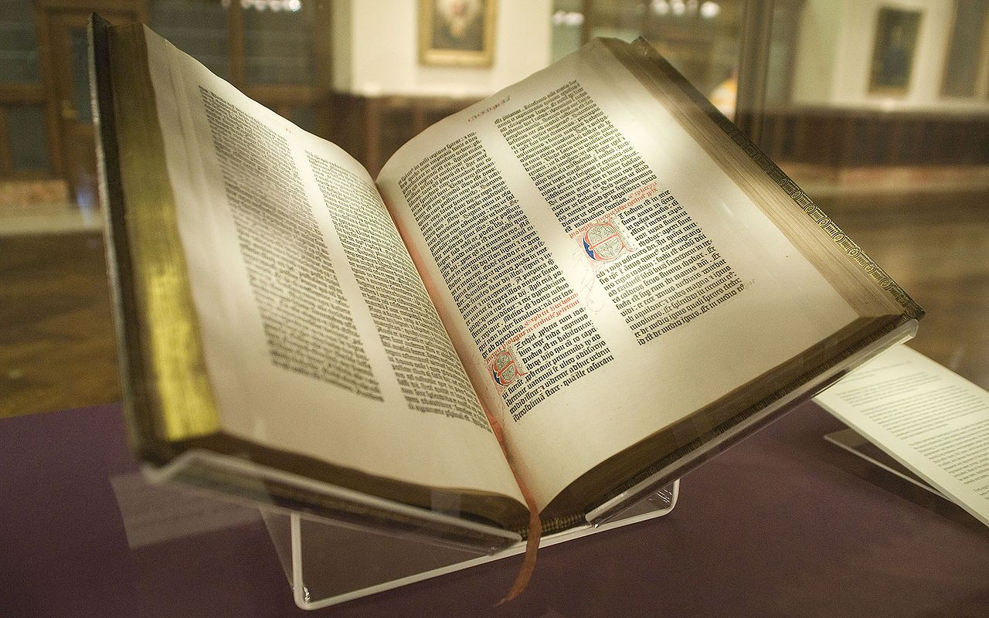
Gutenberg Bible
Starting in the 1450’s, Gutenberg began printing mass copies of the Bible. Around 180 copies were produced.
42 known copies still exist, 21 of those are complete. They fetch anywhere between $2.2 million and $20.4 million.

Slide 11
Protestant Reformation
2 Factors that lead to Reformation:
Around 1517, people such as John Calvin and Martin Luther began to push against the monetary gains and indulgences of the Catholic church.
With the invention of the printing press and the mass production of books (specifically bibles), the literacy rate among Europeans increased.

Slide 12
Quiz
Who invented the movable type printing press?
What was one of the first books to be copied?
How did the printing press spark reformation?
How did Martin Luther play a role in the reformation?

Slide 13
Martin Luther
In 1517, Luther published his Ninety-Five Theses, or in short, 95 problems with the Catholic Church.
Luther creates the good church vs. bad church pamphlets, and along with his Ninety-Five Theses, spreads over 10,000 pamphlets across Europe.
Due to the increased literacy rates, Lutheranism spreads on “protest” against the Catholic Church begins.

Slide 14
Principles of the Reformation
The Catholic Church should not collect payments in replacement for forgiveness of sins.
Salvation is based on God’s grace, not good deeds done during life.
The Bible, not the Pope, is the only source of divine knowledge.

Slide 15
Diet of Worms
In 1520, Pope Leo X identified 41 errors in Martin Luther’s 95 Theses.
In 1521, at Worms, Germany, Luther was placed on “trial” to determine the authenticity of Luther as the author.
Luther acknowledged his authorship, the book was banned by the Church, and Luther was considered an outlaw, expecting to be arrested upon his return home.

