Slide 1
The Renaissance
A period of “re-birth” in thinking that occurred in Europe from around 1350-1600.
The Renaissance movement began in Italy, which at the time was the most “urban” of all the regions in Europe.
The Italian population boom can be traced to its many merchant trading centers (i.e. Venice).

Slide 2
A. Describe how Italy was divided and governed prior to and during the Renaissance.
B. Explain how trade can lead to economic prosperity and political power.

Slide 3
The Italian States
Italy was divided into three regions:
The 3 major city-states of the north
Florence
Milan
Venice
The Papal State, which was the area surrounding Rome
The Kingdom of Naples in the south

Slide 5
Visconti and Sforza Families
By the late 13th century, the Visconti family established complete control over the city state of Milan.
By 1447, after the death of the last ruling Visconti, the Sforza family took control of the government.
The Sforza family was one of the first to use mercenaries, or soldiers that fought for money, to control the government.

Slide 6
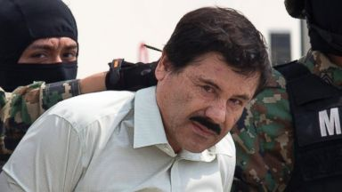
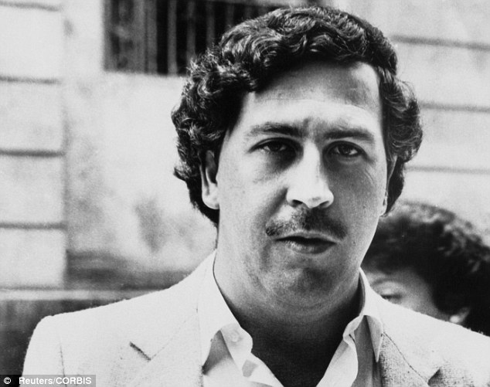

Slide 7
Politics in Italy
At this point, certain city-states were ran efficiently by good leaders, but most were ran by a few aristocrats who were looking to pocket revenue from trade for their own benefit. This soon led to a fight for wealth between the major city-states.

Slide 8
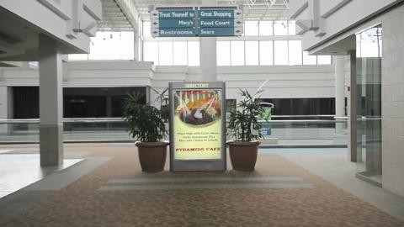
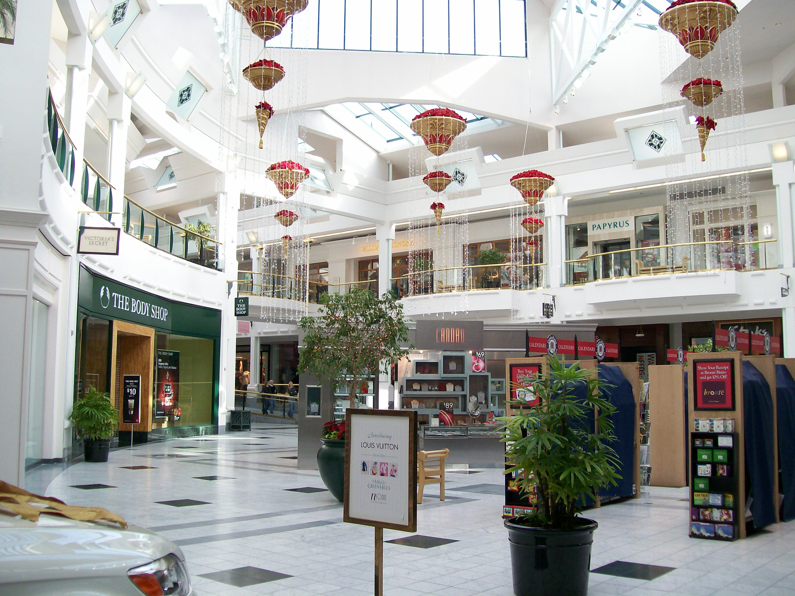

Slide 9
Medici family
In 1434, the wealthy banking family that had made their riches in the textile trade, began to control the city of Florence from behind the scenes.
The Visconti, Sforza, and Medici families are in large part responsible for creating an environment and ideology where the Renaissance could flourish.
All 3 families created a tax system that helped generate large amounts of revenue for their cities and underwrote famous Renaissance men of the time, or provided them money.

Slide 10
C. Explain how Machiavelli’s The Prince changed/exposed the thought process of leaders.
D. Give examples of how the principles of The Prince are used today.

Slide 11
Niccolo Machiavelli (1469-1527)
Italian philosopher born in Italy
Wrote his masterpiece, The Prince, after he had served as leader of the Florentine militia and a high ranking Florentine diplomat.
The Prince is a book dedicated to Lorenzo de’ Medici, and describes how to gain and maintain leadership.
The book was not published until after his death.

Slide 12
What made The Prince different?
Most European political writers of the time focused on the value of morality and Christian principles when leading a country.
Machiavelli believed morality was unrelated to politics. He also believed humans were motivated by self interest, and “as long as you succeed they are yours entirely”.

Slide 13
You will have two daily assignments and one now and one at the end of class.
For the first you will read two passages from The Prince and answer four questions. When finished, we will discuss (as a class) your answers. You may work within your group.
At the end of class we will read a third passage. For this passage, keep in mind how the leaders of today conduct business. You will pick a leader of today (politician, business owner, sports team executive, athlete, etc.) and write a paragraph describing how that person applies Machiavelli’s principles set forth in The Prince.

Slide 14
Machiavelli on Trust and Force
“Every one admits how praiseworthy it is in a prince to keep faith, and to live with integrity and not with craft. Nevertheless our experience has been that those princes who have done great things have held good faith of little account, and have known how to trick the intellect of men by craft, and in the end have overcome those who have relied on their honest principles. You must know there are two ways of contesting, the one by the law, the other by force; the first method is proper to men, the second to beasts; but because the first is frequently not sufficient, it is necessary to have recourse to the second. Therefore it is necessary for a prince to understand how to avail himself of the beast and the man.”
Niccolo Machiavelli, The Prince

Slide 15
Humanism
Humanism was based on the study of the classics (ancient Greek and Roman literature).
Humanism was a movement away from the religious ways of thinking and a movement toward more rationale (human) ways to solve problems.
Today, the humanities (subjects) are made up of history, philosophy, and english (rhetoric and poetry).

Slide 16
Famous Humanists
Francesco Petrarch (PEE-TRAHRK) – searched throughout Europe to find old and forgotten Latin manuscripts. Described intellectual life as one of solitude, rejecting family and social life, instead pursuing civic life for the benefit of all.
Christine de Pizan – French writer who wrote and defended the rights of women, stating that if women had the same access to school as men, they could learn just as well (most male intellectuals at the time thought opposite).

Slide 17
Vernacular
Vernacular is the use of common, everyday language in a particular region.
Prior to the Renaissance, most intellectuals in Europe wrote their scholarly works in Latin, which was nearly impossible for the “normal” person to understand.
The increased use of the vernacular languages made it possible for a larger percentage of the general population to understand important works, therefore making them more popular.

