Slide 1
Imperialism
Define Imperialism.
What were the motivations for new imperialism?
What led to Western dominance is Southeast Asia?

Slide 2
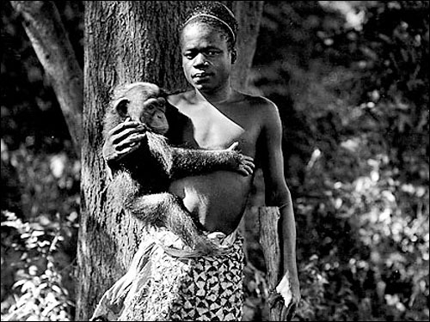
18th and 19th century human zoos
Several thousand persons took the Subway, the elevated, and the surface cars to the New York Zoological Park, in the Bronx, yesterday, and there watched Ota Benga, the Bushman, who has been put by the management on exhibition there in the monkey cage. The Bushman didn't seem to mind it, and the sight plainly pleased the crowd.
The African Pigmy, "Ota Benga."
Age, 23 years. Height, 4 feet 11 inches. Weight, 103 pounds. Brought from the Kasai River, Congo Free State, South Cen- tral Africa, by Dr. Samuel P. Verner. Ex- hibited each afternoon during September.

Slide 3
A. Define Imperialism
Imperialism – the extension of a nation's power over other lands.
Many historians have coined the term "new imperialism" to describe the period after the Industrial Revolution when the industrialized nations of Europe began to compete with one another to acquire overseas colonies.
This created an intense rivalry based on economic and military power.
Southeast Asia
Africa
British rule in India
Latin America

Slide 4
B. What were the motivations for the new imperialism?
1. A need for more natural resources and raw materials to produce goods in the increasing amount of European factories.
2. To create more markets in which to sell the goods produced in European factories.
Both differed from "old imperialism" in which countries were content with establishing simple trading posts and carrying out missionary work.
3. Acquiring overseas colonies led to an advantage over other countries.
Led to national prestige
Many believed that a country could not be great without overseas territories.

Slide 5
B. What were the motivations for new imperialism? (why did Europeans think they had a right to do this?)
Social Darwinism and racism:
Some Europeans believed in Darwin's idea that the fittest will survive, and that race was a determinant of one's traits and capabilities.
Led to the idea that certain races were superior and inferior.
https://www.youtube.com/watch?v=5W4rABjLSU4

Slide 6
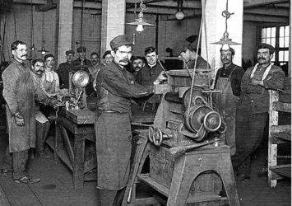
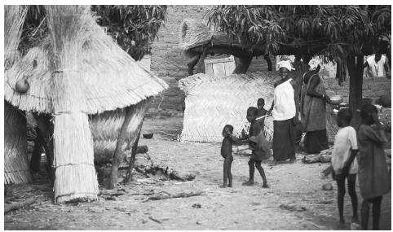

Slide 7
B. What were the motivations for new imperialism? (why did Europeans think they had a right to do this?)
"White Man's Burden" (Rudyard Kipling) – idea that Europeans had a moral obligation to transform overseas territories the following three ways:
Introduce and convert to Christianity
Introduce democracy
Introduce capitalism and free markets

Slide 8
Assessment
Define imperialism.
Which regions of the world did Europeans imperialize (list 3)?
List 3 reasons Europeans imperialized.
Describe the idea of Social Darwinism.
How did Kipling’s “White Man’s Burden” relate to Imperialism?
For later….
Does imperialism still exist today? Defend your position.

Slide 9
D. Why did European countries compete for colonies in Africa?
By 1864, raw materials such as peanuts, timber, hides, and palm oil had enticed Great Britain, France, and Germany to annex parts of West Africa.
In Northern Africa, specifically Egypt, the Nile River Valley was a sought after commodity.

Slide 10
Suez Canal
The Europeans especially had an interest in building a canal in Egypt that would connect the Mediterranean Sea to the Red Sea, creating an easier trade route to Asia (eliminating having to sail the tip of Africa).
In 1854, French entrepreneur Ferdinand de Lesseps funding the construction of the Suez Canal. It was completed in 1869.

Slide 11
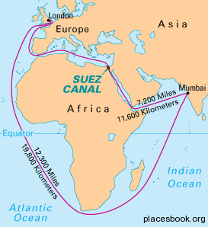

Slide 12
Bell Work
Answer questions 1-3 on your worksheet from Tuesday. Pay close attention to number 2, it will take some analytical skills to determine the answer. Special reward to those that manage the best answer. Work with your group. We will discuss when finished (5-7 minutes). If you need another worksheet, let me know.

Slide 13
Imperialism of Africa
Compare the progression of imperialistic claims on the African continent using historical maps.
Why did European countries compete for colonies in Africa, and describe how/why that led to the Berlin Conference.
W.17 Compare the progression of imperialistic claims on the African continent using historical maps.
W.15 Describe the Berlin Conference and the rise of modern colonialism in the 19th century and describe the impact of colonization on indigenous populations by such nations as England, France, Germany, Italy, Spain, and the United States.

Slide 14
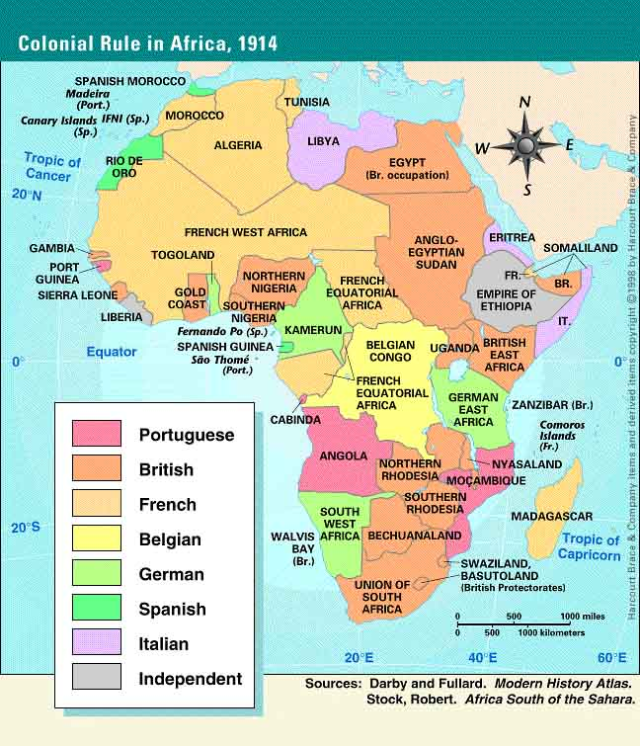

Slide 15
Scramble for Africa
The desire for resources and trade led to competition among the European powers.
Plant a flag, control the people
The Scramble leads to conflict among the European powers.

Slide 16
D. Why did European countries compete for colonies in Africa?
In 1877, King Leopold II of Belgium hired Henry Stanley to set up colonies in the region.
The French rushed to plant a flag in the center of Africa. French north/Belgian south. Portugal was also involved.
Germany and Great Britain were at odds over East Arica.
The “Scramble for Africa” led to the Berlin Conference.

Slide 17
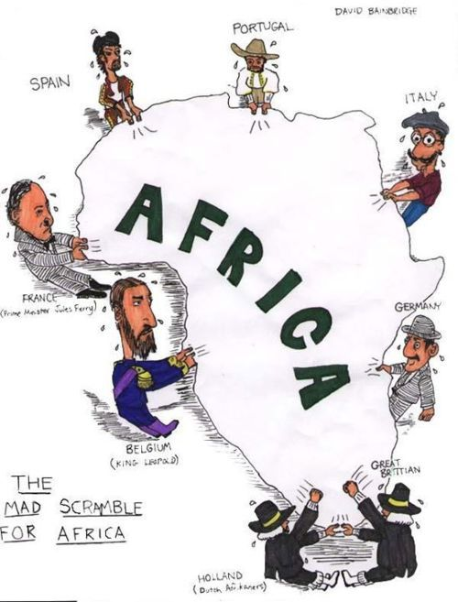
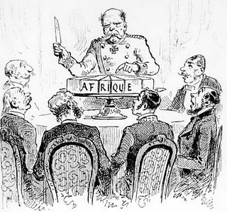
D. Why did European countries compete for colonies in Africa?
To settle these conflicting claims, Europeans met at the Berlin Conference in 1884.
No African delegates were present.
Africa was officially divided amongst the European countries.
Otto von Bismarck of Germany led the delegation.

Slide 18
Group Activity
Your group will represent one of the countries listed on the board.
Your groups Is tasked with determining what land in Africa your country wants to claim and why it wants that land.
Use the maps in your book to determine why you might want that land.
Your group will present your request to me through the request form. I can deny it for any reason. If that happens, re-submit a second request.

Slide 19
Assessment
We will complete the chart on the board as a class.

Slide 20
Ethiopia and Liberia
In 1896, Italy failed to defeat the Ethiopians for control of their country, being the only European country to be defeated by an African nation.
Liberia was a former U.S. colony established for former slaves.

Slide 22
Assessment
Correct answers for questions 1-4
Kahoot!

Slide 23
C. What led to Western dominance in Southeast Asia?
By 1800, Europeans only controlled two regions of Southeast Asia, the Spanish Philippines and the Dutch East Indies.
Great Britain
Colonial takeover in the region started with Great Britain in 1819 in Singapore, due to its central location for the new steamships traveling the region.
A few decades later, Great Britain took control of Burma (Myanmar) to create a buffer for India and establish a land route to China.

Slide 24
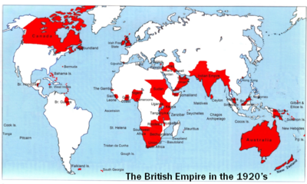

Slide 25
C. What led to Western dominance of Southeast Asia?
France
By the mid 1800's, France had Christian missionaries working in Vietnam.
However, the Vietnamese rulers persecuted the French missionaries trying to push Christianity on their Confucian population.
This led to a divide in the countries – north and south
In 1857, the French convinced the Vietnamese to accept French protection from the British who were rapidly monopolizing the region.
By 1883, Vietnam was officially a protectorate of France.
By 1887, France had moved into neighboring Cambodia, Tonkin, and Laos.
*During this time, Thailand manages to convince France and Great Britain to allow it to remain independent. Both sides agree, using it as a buffer between the two countries overseas colonies.

Slide 26
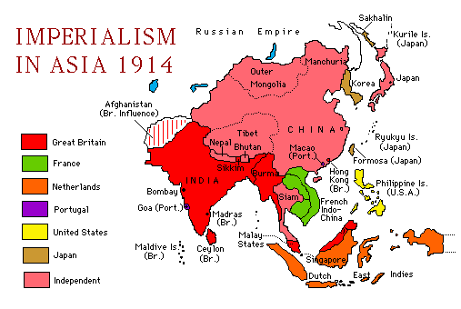

Slide 27
Imperialism in Southeast Asia (cont.)
D. Describe American imperialism in the Philippines and the Philippine-American War led by Emilio Aguinaldo.

Slide 28
D. Describe American imperialism in the Philippines and the Philippine-American War led by Emilio Aguinaldo.
The United States
During the Spanish-American War of 1898, the U.S. defeated Spanish forces in the Philippines and took control of the country.
President William McKinley decided to turn the Philippines into an American colony for three reasons:
He believed it to be his moral obligation to "civilize" the people of the islands.
He wanted to establish easier access to trade with the Chinese.
He did not want the Philippines to fall under control of the Japanese.

Slide 29
D. Describe American imperialism in the Philippines and the Philippine-American War led by Emilio Aguinaldo.
Emilio Aguinaldo – Disapproved of the western presence in the Philippines and wished to see the country as an independent nation.
Initially fought against the Spanish for independence until the United States took control of the Philippines in 1898.
In that same year, Aguinaldo returned from exile (placed there by the Spanish) and named himself president of the Philippines.
In the following three years, Aguinaldo led guerilla forces against the United States in the Philippine-American war.
In 1901, Aguinaldo was captured and the war came to an end.

