Slide 1
Pacific Theater W.47 Identify and locate the Allied and Axis powers and explain the major battles of the Pacific and European theaters of war including the blitzkrieg, Dunkirk, Battle of Britain, Stalingrad, Normandy, Midway, Battle of the Bulge, Iwo Jima, and island hopping. W.51 Analyze the decision to use nuclear weapons to end World War II.
Identify the Battle of Midway and island hopping, and describe how they served as turning points in the Pacific.
Identify Iwo Jima and explain its significance.
Analyze the decision to use nuclear weapons to end WWII.

Slide 2
Pre-assessment
Where is Midway Island?
What was the significance of the Battle of Midway Island?
Who was victorious? To what extent?
Why did the Battle of Midway serve as a turning point in WWII?
What is island hopping?

Slide 3
A. Identify the Battle of Midway and island hopping, and describe how they served as turning points in the Pacific.
By the summer of 1942, the U.S. had mounted a strong defense against the aggressive Japanese military (Greater East Asia Co-Prosperity Sphere).
On June 4, at the Battle of Midway Island (map), Japan attempted to “trap” U.S. aircraft carriers.
However, U.S. codebreakers were able to determine the date and location of the attack and mount an ambush of their own.
Over a 3 day period, the Japanese lost 4 of 6 aircraft carriers and 1 heavy cruiser.
The U.S. lost 1 aircraft carrier and a battleship.

Slide 4
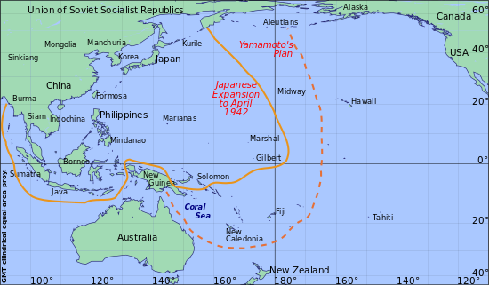
Japanese expansion and Midway

Slide 5
A. Identify the Battle of Midway and island hopping, and describe how they served as turning points in the Pacific.
Why was it a turning point?
It was the first Japanese naval defeat since 1863.
The massive industrial capabilities of the U.S. were able to quickly replace material losses whereas the Japanese struggled to build new ships.
The Japanese had trouble finding capable pilots to continue the war (kamikaze).
The combination of these factors made it possible for the Allies to carry out more attacks against the Japanese mainland through island hopping.

Slide 6
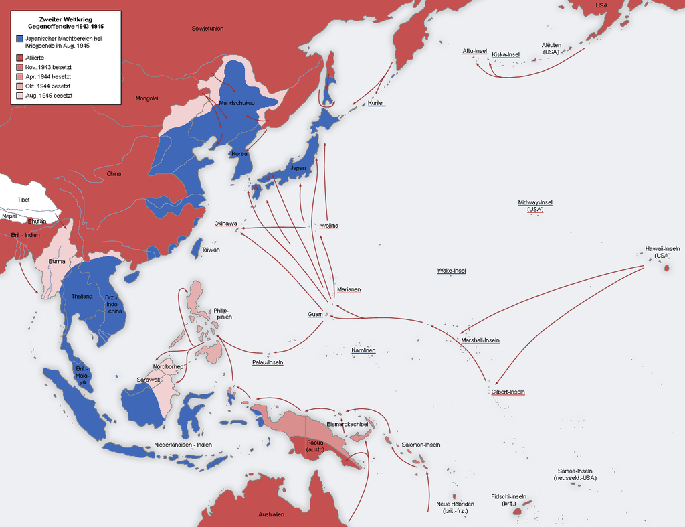
Island hopping/leapfrogging

Slide 7
A. Identify the Battle of Midway and island hopping, and describe how they served as turning points in the Pacific.
Why island hopping?
To avoid heavily defensed Japanese islands.
To more efficiently use limited Allied resources to attack islands that were not heavily defensed but capable of supporting the drive to attack the Japanese mainland.
Ex: By claiming islands closer to Japan, the allies were able to scramble personnel, aircraft, and ships faster.

Slide 8
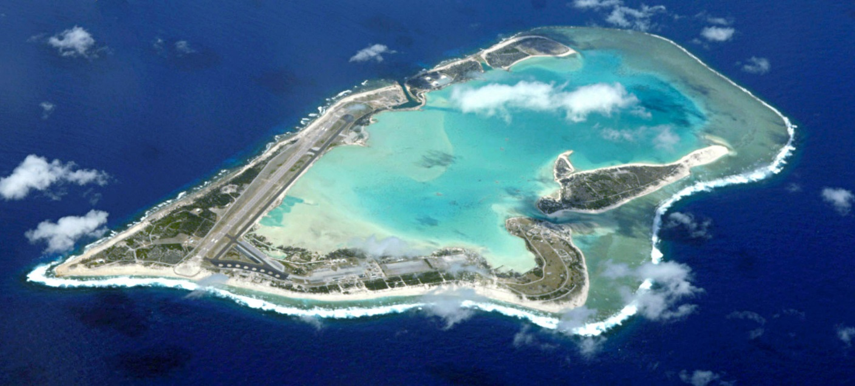
Wake Island

Slide 9
Assessment
Where is Midway Island?
What was the significance of the Battle of Midway Island?
Who was victorious? To what extent (what were the losses?)?
Why did the Battle of Midway serve as a turning point in WWII (why did it hinder Japanese success?)?
What is island hopping? Evaluate why the Allies island hopped instead of directly attacking Japan.

Slide 10
B. Identify Iwo Jima and explain its significance.
By the start of 1945, the Allied island hopping campaign was drawing to an end.
The capture of the islands of Iwo Jima and Okinawa placed the allies on the southern doorstep of Japan.
Of the 22,000 Japanese soldiers on the island, it is estimated that only 3,000 survived.
Iwo Jima has three airstrips that were to be used in the attack against the Japanese mainland.
The losses on the American side were also tremendous.

Slide 11
C. Analyze the decision to use nuclear weapons to end WWII.
Background:
Harry Truman becomes president in April, after the death of Roosevelt.
Truman and his advisors were concerned with the extent of American casualties if they were to invade Japan and thought the Japanese would not be willing to surrender.
Idea of bushido – way of the warrior (samurai), death was not ultimate end.
Japanese propaganda – English speaking demonic beasts
Secret Manhattan Project – creation of two atomic bombs – Enrico Fermi

Slide 12
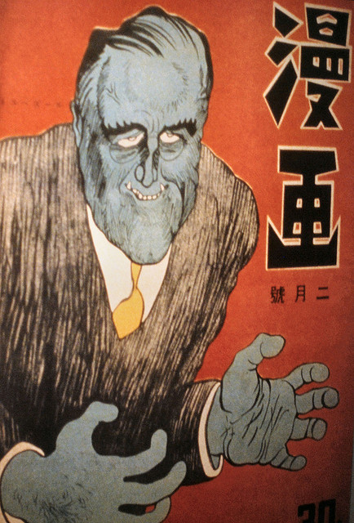
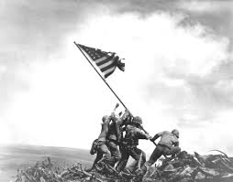

Slide 13
C. Analyze the decision to use nuclear weapons to end WWII.
August 6 - The first bomb was dropped on Hiroshima.
Of the cities 350,000 inhabitants, 190,000 died.
August 9 – The second bomb was dropped on Nagasaki and the U.S.S.R. sent 1.6 million troops to invade Manchuria.
The U.S. readied one more bomb to be dropped in August, three in September, and three more in October if needed.
The Japanese unconditionally surrendered on August 14. WWII was over.
As many as 60 million people died, 20 million of which were civilians.

Slide 14
C. Analyze the decision to use nuclear weapons to end WWII.
"The fundamental issue that has divided scholars over a period of nearly four decades is whether the use of the bomb was necessary to achieve victory in the war in the Pacific on terms satisfactory to the United States.“ – J. Samuel Walker

Slide 15
Pro-Atomic Bombs
Japanese slogan: “One hundred million will die for emperor and nation.”
Refusal to surrender
Churchill: “(the bombs) saved 1 million American lives and half that number of British lives”
Other strategies could have been used to force Japan into surrender, but those would have likely cost more Japanese lives.
August 1, 1944 Japanese order: execute all Allied POWs held in combat zones.

Slide 16
Anti-Atomic Bombs
Atomic bombs are ethically immoral
The bombings counted as war crimes against the innocent.
The bombs involved racist motives against the Japanese.
(13% of Americans supported the complete extermination of Japanese men, women, and children) Arthur N. Feraru, Far Eastern Survey Vol. 19, No. 10 (May 17, 1950), pp. 101-103
The U.S. was already using conventional bombs against Japanese strategic points, Germany had surrendered, Japan was being blockaded by the Allies, and the U.S.S.R. invaded August 9. Surrender would have came.
Japanese textbooks: idea of atomic diplomacy. The U.S. used atomic bombs to intimidate the U.S.S.R. in the early stages of the Cold War.

Slide 17
Assessment
Write the body of a two point essay describing your views on the use of nuclear weapons against Japan.
Give two reasons as to why the United States should or should not have used atomic bombs against Japan.
Back up your argument with factual evidence.
You will be graded on clarity and ability to coerce the reader, which means that you may need to explain why the counter-view is NOT a good idea.
This same question will be included on your next test.

Slide 18
The End of WWII
W. 53: Evaluate the goals, leadership, and postwar plans of the principal allied leaders: the Atlantic Conference, Yalta, and the Potsdam Conference.
D. What led to the Cold War?
Atlantic Charter
Yalta Conference
Potsdam Conference

Slide 19
D. What led to the Cold War?
Who are the major allied leaders at this time (Big Three)?
United States –
Soviet Union –
Great Britain --
Atlantic Charter (Conference): created in 1941, after the U.S. entered the war. It outlined the Allied goals for a post-war world.
No territorial aggrandizement
No territorial changes against the wishes of the people*
Restoration of self government to those deprived of it (Roosevelt)*
Abandonment of the use of force
Disarmament of aggressor nations

Slide 20
D. What led to the Cold War?
Yalta Conference: Held prior to Germany’s surrender in Feb. 1945.
Stalin, fearful and suspicious of the Western aggression, wanted a buffer zone created in Poland.
Roosevelt still wanted the people of Europe to have the right to “democratic institutions of their own choice” through free elections, but did not push as hard.
Germany would be divided into 4 zones, controlled by each of the allies (map).
Forced labor of German P.O.W.s (4 million in U.S.S.R.).
German unconditional surrender, demilitarization, and payment of reparations.
U.S.S.R. agreed to aid Allies.

Slide 21
D. What led to the Cold War?
Potsdam Conference: occurred immediately after German surrender but BEFORE Japanese surrender (July-August 1945).
Tensions arise between Truman and Stalin. Truman, not as trusting as FDR, demanded free elections in Europe. Even mentioning a “powerful new weapon” and providing an ultimatum to Japan.
Surrender or face “utter and prompt destruction”
Stalin: “A freely elected government would be anti-Soviet, something we cannot allow”.
Stalin takes control of lands east of Berlin (Eastern Bloc), knowing that a Western invasion was not likely.
Westerners view Stalin’s policies as communist expansion.
Churchill: “an iron curtain has descended across the continent”

Slide 22
Assessment
Describe how the policies of the Atlantic Charter were undone by the Potsdam Conference.
List four consequences placed on the Germans during the Yalta Conference.
Describe how Roosevelt and Truman’s views of Stalin differed. Has your view about the use of nuclear weapons changed? Elaborate.

Slide 23
The Holocaust
W. 50 - Write an opinion piece on the impact of the Holocaust on the Jewish populations in Europe and Israel.
W.56 Explain the origins, significance, and effect of the establishment of the State of Israel.
E. Evaluate life as a Jew under Nazi control and describe the effects on the Jewish population in Europe. F. Describe the Zionist movement.

Slide 24
E. Evaluate life as a Jew under Nazi control and describe the effects on the Jewish population in Europe.
Hitler’s correction of the problems the Jews created (in his eyes) was carried out in what was known as the Final Solution – or genocide of the Jews.
SS death squads (Einsatzgruppen) were established after the defeat of Poland (1939) and initially given the task of forcing Polish Jews into ghettos, where living conditions were horrendous and crowded.
By June 1941, the death squads were given the job of following the German military into the U.S.S.R., rounding up Jews, and slaughtering them.

Slide 25
E. Evaluate life as a Jew under Nazi control and describe the effects on the Jewish population in Europe.
For Hitler, the process of moving place to place to execute Jews was too slow.
Starting in 1942, six “extermination” centers were set up in Poland (the largest – Auschwitz).
Life in concentration camps:
Jews were rounded up and packed on trains like cattle, and taken to the nearest camp.
Upon arrival, 30% were sent to labor camps, where they were worked or starved to death.

Slide 26
E. Evaluate life as a Jew under Nazi control and describe the effects on the Jewish population in Europe.
Life continued:
The remainder of Jews were usually sent to the gas chambers, or underwent cruel and painful “medical” experiments.
Death toll:
Approximately 6 million Jews were killed, 3 million in death camps.
90% of the Jews in Germany, Poland, and the Baltic countries were killed.
Due to the focus on the war itself, the atrocities of the camps went largely unnoticed until after the war.
The genocide movement against the Jews led to increased immigration into Palestine (Israel), known as Zionism.

Slide 27
Assessment
Put yourself in the shoes of a Jewish student that has been sent to a concentration camp in Germany.
Write three days of journal entries describing the physical and emotional effects that have been placed upon you by life in a concentration camp.
At some point within your journal, give one example as to why you are concerned about the future of your race. Use data discussed in class.

Slide 28
F. Describe the Zionist movement.
Israel – land of the Hebrews before exile (538 BC)
Palestine – conquered by Islamic empire in 634 AD.
In 1917, the World Zionist Organization started a push for Jews to immigrate back to “the homeland.”
The atrocities in Eastern Europe against Jews started an increase in the movement by the 1930’s and 40’s.
In 1948, the United Nations had to step in to divide the territory amongst Jews and Palestinians.
Israel was granted to the Jewish population and the Palestine had their territory divided amongst the Golan Heights, West Bank, and Gaza Strip.

Slide 29
