Slide 1
Russian Revolution
State Standard W.41 Draw evidence from literary or informational texts determining the causes and consequences of the Bolshevik Revolution and Civil War in Russia, including Lenin’s use of totalitarian means to seize and maintain control including the Gulag.
What factors and events led to the Russian Revolution?
How did Russia move from a czarist regime to a Communist regime?
What forces opposed the Communist government?
What factors helped the Communists win the Russian civil war?

Slide 2
A. What factors and events led to the Russian Revolution?
1. Even after its defeat by Japan in 1905, Russia was still unprepared for World War I.
Soldiers trained with broomsticks
Soldiers were sent into battle without guns and told to pick one up when another soldier died.
This was due to the poor Russian manufacturing sector.
Czar Nicholas II chose to take personal control of the armed forces, knowing little about military strategy.

Slide 3
A. What factors and events led to the Russian Revolution?
2. While Czar Nicholas II was at battle, his wife Alexandra made most of the executive decisions. It is likely that Grigory Rasputin advised Alexandra.
After becoming a religious wanderer and mystic, Rasputin was “hired” as a healer to the Czar’s son Alexei.
Alexei had hemophilia which brought on painful bleeding.
Alexandra, who was very religious held Rasputin’s advice in high regard.
Because of his relationship with Alexandra, Rasputin took blame for the economic and political problems in Russia.
He was assassinated in 1916, but his actions had already tarnished the image of the monarchy.

Slide 4
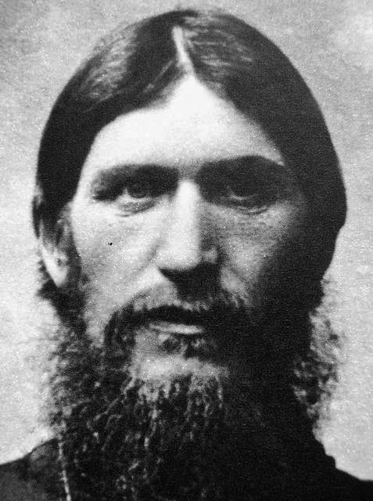
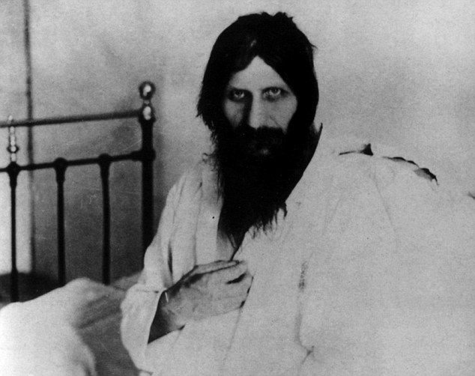
Rasputin

Slide 5
A. What factors and events led to the Russian Revolution?
3. Women’s Revolt of 1917
Since the price of bread skyrocketed, the government began to ration it.
About 10,000 women, who were exhausted from factory work, distraught about their starving children, and tired of standing in lines each day, pushed all workers of Petrograd (St. Petersburg) to go on strike.
When Nicholas II heard of this, he ordered to strikers to be shot if necessary.
Instead, soldiers refused to shoot and instead join the demonstrators.
A few days later the Duma, or legislative body (that the czar had attempted to dissolve) urged the czar to step down.
Since the czar had little support from his military, or even the aristocrats, he decided to step down, ending the 300-year old Romanov dynasty.

Slide 6
Daily Assignment/Bell Work
List three factors/events that led to the Russian Revolution.
Why was Russia so unprepared for WWI?
Who was Rasputin?
Why did the Women’s revolt occur?
How did the soldiers respond?

Slide 7
B. How did Russia move from a czarist regime to a Communist regime?
The newly established provisional government faced a challenge in its authority by the soviets.
The soviets consisted mostly of Socialists, who represented the more radical interests of the lower class.
One sub-group within the soviets was the Bolsheviks.
Led by V.I. Lenin
Part of the Marxist movement of Russian Social Democrats
Dedicated to violent revolution. They believed that was the only way to destroy the capitalist system.

Slide 8
B. How did Russia move from a czarist regime to a Communist regime?
With the Russian government in transition, Lenin knew this would be a good opportunity for the Bolsheviks to seize power.
Lenin was traveling abroad. The German’s knew that Lenin would create chaos and disorder in Russia, so they gladly found Lenin and shipped him back to Russia. Lenin was sent in a train and never granter access to Germany. They were fearful his ideas would infect Germany.
Upon his return, Lenin convinced soldiers, factory workers, and peasants to join his new Communist party by promising them land reform and that he would transfer all industry from the capitalists to committees of workers.
“Peace, Land, Bread”
“Worker Control of Production”
“All Power to the Soviets”

Slide 9
B. How did Russia move from a czarist regime to a Communist regime?
During the night of November 6, 1917, the Bolsheviks seized power of the government with little bloodshed.
Lenin created a Congress of Soviets, but in reality ruled as a dictator.
His first order of business was to sign a treaty with the Germans, which meant giving up Eastern Poland, Ukraine, Finland, and the Baltic Provinces. Peace for the Russians was costly, but Lenin argued that it did not matter because socialism would soon spread throughout Europe.
However, Russia was on the verge of another war, civil war.

Slide 10
C. What forces opposed the Communist government?
Russia’s new Communist government faced resistance on many fronts.
Anti-Communist parties that were still loyal to the czar.
The Allied nations worried about a Communist takeover.
Aided non-Communist parties fighting to win the government back.
Ethnic groups from Siberia, Ukraine, and the Baltic Region fought a series of wars with Russia between 1918-1921, but were unsuccessful in overthrowing the Communist government.
“Red” Army vs. “White” Army
Ukraine was taken back in the process.
Georgia, Armenia, and Azerbaijan were also converted to Communist control.
The previous ruling family of Czar Nicholas II, who were being held as prisoners, were murdered and burned in the process.

Slide 11
D. What factors helped the Communists win the Russian civil war?
Instead of being unprepared and unorganized like the old Russian military, the new military was led by Leon Trotsky.
The draft was reinstated
Discipline was a focus. Soldiers that did not obey were executed on the spot.
Production during war was mostly controlled by the government, ensuring there would be no more shortages.
The Red Police called the Cheka were responsible for carrying out the Red Fear – executing those who did not side with the Communist regime.
A sense of nationalism and patriotism was created to help increase the enthusiasm of fighting, especially against the Allies (like Asia and Western ideas).

