Slide 1
The Cold War
W.53 Evaluate the goals, leadership, and postwar plans of the principal allied leaders: the Atlantic Conference, Yalta, and the Potsdam Conference.
W.55 Describe the nature of reconstruction in Europe after 1945, including the purpose of the Marshall Plan and the division of Germany.

Slide 2
Schedule
2-3 minutes: Bell work
5 minutes: work in groups (final time in class) to practice role play
3-5 minutes: Group 1, The Cold War Begins
5-7 minutes: Slide 1 notes – review Stalin/Truman relationship and atomic diplomacy
Why did the U.S. and the U.S.S.R. become political rivals after WWII?
3-5 minutes: Group 2, The Domino Effect and Containment
Explain how the Marshall Plan was used to halt the Domino Effect.
5-7 minutes: Slide 2 notes – review containment/Marshall Plan/Domino effect
5-7 minutes: Assessment

Slide 3
A. Why did the U.S. and the U.S.S.R. become political rivals after WWII?
What are the differences in political ideology between the U.S. and the U.S.S.R.?
How might “atomic diplomacy” create more tension between Truman and Stalin?
Before atomic bombs: Truman offers Stalin control of Manchuria.
After atomic bombs: Truman doesn’t follow through, creating more distrust between the two sides.

Slide 4
B. Explain how the Marshall Plan was used to halt the Domino Effect.
Marshall Plan (1947)
AKA the European Recovery Program
U.S. offers loans to European nations ($13-22 billion)
Plan to halt the spread of Communism into war torn nations of Europe, both developed and strategic (Turkey/Greece).
Stalin’s view: the U.S. was using these loans to imperialize.
Why did Greece and Turkey’s geographic location play a role in the United State’s decision to provide them financial aid.

Slide 5
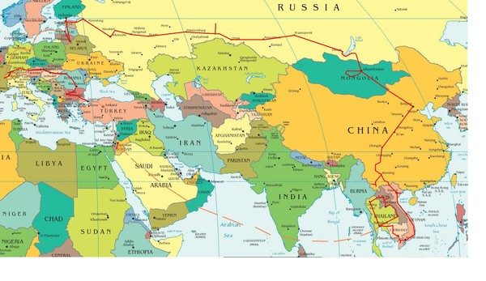
What is containment?
What is the Domino Effect?

Slide 6
Assessment
What are the differences in political ideology between the U.S. and the U.S.S.R.?
How might “atomic diplomacy” create more tension between Truman and Stalin?
What is containment?
What is the Domino Effect?
How did the United States use the Marshall Plan to “contain” communism?
Why did Greece and Turkey’s geographic location play a role in the United State’s decision to provide them financial aid.

Slide 7
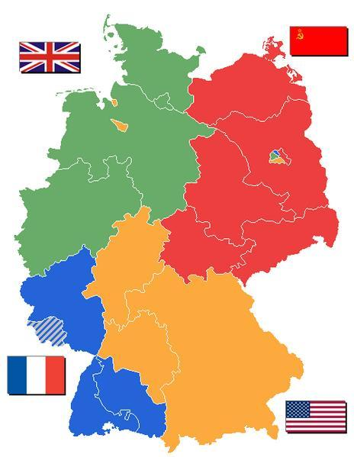
C. How did the Berlin Airlift lead to further tension between the Soviets and the West? W.60 Trace Soviet aggression in Eastern Europe, including conflicts involving Berlin and the Berlin Wall.
Notice Berlin (top right). Is it divided? How would the West give aid to those in West Berlin if the Soviets disallowed it?

Slide 8
C. How did the Berlin Airlift lead to further tension between the Soviets and the West?
Pre-Berlin Airlift
The Western powers sought to unite both the governments and economies of their respective zones.
Stalin, fearful that the West would encourage the spread of democracy and capitalism through the 2.5 million citizens of West Berlin, blockaded the entire city.

Slide 9
C. How did the Berlin Airlift lead to further tension between the Soviets and the West?
Berlin Airlift (1949)
Stalin did not allow Western trains, trucks, or barges to enter the city’s western half.
Stalin’s plan was to force the West into giving up control of Berlin, creating a solid, unified Eastern Germany.
Western solution: for 10 months, over 200,000 flights would drop 13,000 tons of food daily to those in West Berlin.
Fearing WWIII, the Soviets ended the blockade.

Slide 10
C. How did the Berlin Airlift lead to further tension between the Soviets and the West?
Outcome of the Berlin Airlift:
The West would go on to unify West Berlin and West Germany, creating a new democratic state.
The Soviets would also create a new East German state.
By the mid 1950’s, West Berlin would become the “Western island” of prosperity among poverty stricken East Berlin.

Slide 11
D. Explain why the Soviets built the Berlin Wall.
In 1953, Stalin dies.
By 1955, Nikita Khrushchev emerges as the new leader of the U.S.S.R..
Khrushchev, tired of refugees fleeing East Berlin into West, built a concrete wall 15 feet high and 28 miles long throughout the city (1961).
The Berlin Wall now served as a visual landmark of Churchill’s Iron Curtain.

Slide 12
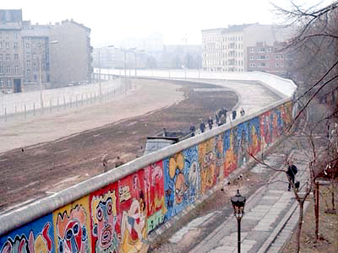
The Berlin Wall
Which side of the wall is the West?
What characteristics led you to that assumption?

Slide 13
Assessment
How many zones was Germany divided into after WWII?
*Bonus (prior learning) – at which conference were these zones established?
True or false: All Berlin zones were landlocked by the Soviet controlled zone.
What concerned Stalin about how the West were planning to manage their zones?
What was Stalin’s response to the West’s plans?
Describe the Berlin Airlift. What was the outcome?
When and why was the Berlin wall built (what were Khrushchev's concerns?)?

Slide 14
Cold War – Proxy Wars W.62 Describe the Soviet-United States competition in Asia with particular attention to the Korean War and Vietnam War.
Proxy War – when two countries in conflict use substitutes instead of fighting each other directly.
Both sides are willing to offer support to aid the side supporting their worldviews.
Democracy vs. Communism
What were the proxy wars of the Cold War?
Korean War
Cuban Missile Crisis
Vietnam War

Slide 15
E. What were the causes and effects of the Korean War?
The Korean War
Background/Causes:
Until 1945, Japan controlled Korea.
After Japan’s defeat the Soviets and U.S. decided to divide Korea into two zones, under the assumption that open elections and the unification of Korea would follow.
As relations between the two deteriorated, Korea remained divided at the 38th parallel between Communists and Anti-communists.
Asian containment

Slide 16
E. What were the causes and effects of the Korean War?
Causes continued:
On June 25, 1950, with the approval of Joseph Stalin, North Korean troops crossed the 38th parallel and invaded South Korea.
The U.S., viewing this as an act of communist expansion, sent troops to repel the invasion.
Concerned, the Chinese sent troops to fight against the anti-communist forces, and a stalemate followed.
Why were the Chinese concerned?

Slide 17
E. What were the causes and effects of the Korean War?
Effects:
After three years of fighting and stalemate, an armistice between the two sides was signed in 1953.
The division of Korea along the 38th parallel still exists today, dividing the country into a communist north and democratic south.
President Dwight Eisenhower adopted a policy of massive retaliation and affirmed military alliances around the world.
Any Soviet attack would be met with the full use of nuclear weapons.

Slide 18
Assessment
Who controlled Korea before the end of WWII and who divided it after the war?
What caused the Korean war?
How long did it last?
What were three outcomes or effects of the Korean War?

Slide 19
F. Explain why nuclear launch sites were established in Cuba.
Cuban Missile Crisis (background):
In 1959, Fidel Castro, established a totalitarian regime in Cuba.
Castro’s new communist government was supported by the U.S.S.R..
Communism now had a presence in the Americas, 90 miles off the coast of Florida.
So what? No big deal right?

Slide 20
F. Explain why nuclear launch sites were established in Cuba.
Since Cuba was previously governed by a U.S. backed dictator, the U.S. felt as though they should take back Cuba (and communism was now so close).
However, Kennedy feared retaliation against West Berlin, or worse (nuclear war).
Instead, Kennedy and the CIA supply exiled Cuban fighters to invade Cuba (Bay of Pigs - 1961).

Slide 21
F. Explain why nuclear launch sites were established in Cuba.
After an embarrassing defeat at the Bay of Pigs, the Soviet Union established a presence in Cuba.
By 1962, Khrushchev began constructing nuclear launch sites in Cuba.
Khrushchev’s reasoning: to counteract U.S. nuclear weapons in Turkey.

Slide 22
G. Describe President Kennedy’s response to the Cuban Missile Crisis? What was the outcome?
By October 1962, Kennedy had established a blockade of Cuba, not allowing Soviet ships carrying nuclear weapons to enter the country.
This allowed Khrushchev and Kennedy thirteen additional days to find a peaceful solution.
Khrushchev agreed to turn back the ships and dismantle the weapons if the U.S. agreed not to invade Cuba and to dismantle nuclear weapons in Turkey.

Slide 23
H. How close were we to nuclear war?
Read the following article from The New York Times, 1992.
Consider the following questions:
Who is providing most of the information used in the article?
What was that person’s role during the Cuban Missile Crisis?
According to this person, what event would have created a 99% probability that nuclear war would have been carried out?
Did the Soviets ever fully establish nuclear weapons in Cuba?

Slide 24
Assessment
Who were the leaders of the following countries during the Cuban Missile Crisis?
Cuba:
Soviet Union:
U.S. (2):
Why was the U.S. so concerned with Castro gaining leadership in Cuba (two reasons)?
Describe the Bay of Pigs and its aftermath.
Describe the outcome of the Cuban Missile Crisis.
Explain how close the world came to nuclear warfare in 1962.

