Slide 1
The French Revolution
1789 – New Constitution of the United States and start of the French Revolution. Unlike the American Revolution, the French Revolution is more complex.
How did the structure of social classes in France lead to discontent?
How did the economic crisis in France lead to the meeting of the Estates-General (sub objective – identify the Estates-General)?

Slide 2
A. How did the structure of social classes in France lead to discontent? Social Classes (estates) in France – late 18th century French population: 27 million
First Estate – Catholic clergy, numbered 130,000, controlled 10% of the land.
Included nobles such as cardinals, bishops, head of monasteries and common, poor parish priests.
Second Estate – nobility, numbered 350,000, controlled 30% of the land.
Often held leadership positions in government
Third Estate – middle class (bourgeoisie) and poor, controlled 60% of the land

Slide 3
A. How did the structure of social classes in France lead to discontent?
Third Estate continued
The third estate was divided even further into middle class and lower class peasants.
Peasants made up approximately 80% of the third estate, meaning the middle class was small.
The third estate were limited in their access to education, well paying jobs, and wealth.
The third estate were also the only class in France that had to pay the taille (TAH-yuh), or France’s chief tax.

Slide 4
A. How did the structure of social classes in France lead to discontent?
The peasants of the third estate also owed certain duties to the nobles. These duties included harvesting the nobles land and paying fees to the nobles for use of the capital that they owned.
These duties were a holdover from medieval serfdom, in which nobles owned all of the land and had peasants work the land in exchange for protection and ability to subsistence farm.
Between the taxes and duties, the peasants greatly resented the nobles.
Urban craftspeople also made up a percentage of the third estate. These people struggled to keep up with the increase in value of goods (poor economy).

Slide 5
A. How did the structure of social classes in France lead to discontent?
The third estate middle class, or the bourgeoisie, numbered about 2 million of France’s population.
The bourgeoisie were of a higher social class than the peasants. They were bankers, merchants, lawyers, doctors, office holders, writers, and industrialists.
The bourgeoisie were upset with the privileges given to the nobles, and wanted change, not to abolish the nobles, but to better their own position.
About 6,500 bourgeoisie had gained “noble status” by the end of the 18th century, mostly through appointment to public office.

Slide 6
A. How did the structure of social classes in France lead to discontent?
What did the nobles and bourgeoisie have in common?
Both were upset with the advantages and privileges that were granted to the monarchs.
Both had an increased interest in the political ideas of the Enlightenment (philosophes).

Slide 7
What were the three estates in 18th century France?
How was each estate divided?
Which estate was the largest?
Which was the only estate to pay the Taille?
Who were the bourgeoisie?

Slide 8
B. How did the economic crisis in France lead to the meeting of the Estates-General
While social structure and enlightened ideas set the stage for the French Revolution, economic problems were the immediate cause of the Revolution.
Bad harvests in 1787 and 1788 led to food shortages and increase in food prices.
Downturn in manufacturing led to decreased supply of certain goods, causing increase in prices.
The decreases in both industries led to higher unemployment. Less goods to manufacture equals less jobs needed.

Slide 9
B. How did the economic crisis in France lead to the meeting of the Estates-General
On the eve of revolution, and with all of the problems the majority of the population were facing, the government continued to spend enormous sums of money on wars and luxuries.
The queen, Marie Antoinette was known for her extravagant spending.
Palace of Versailles – conservatively US $2 billion and as much as US $300 billion

Slide 10
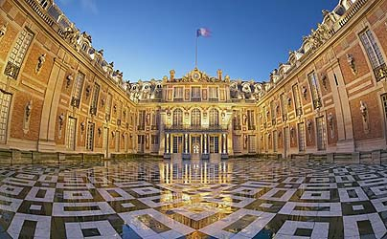
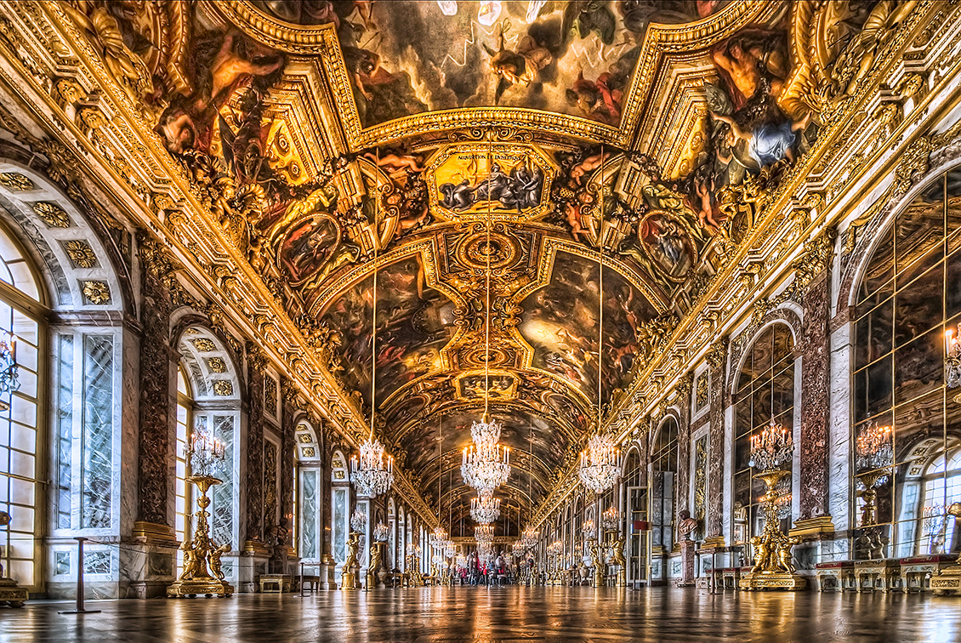
Palace of Versailles

Slide 11
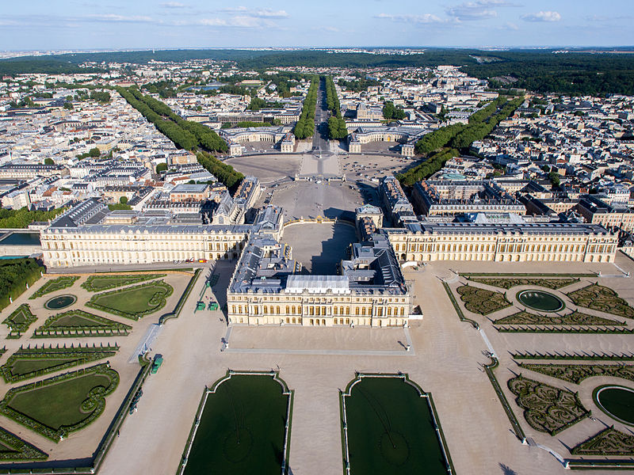
Palace of Versailles

Slide 12
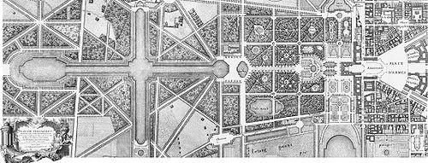
Palace of Versailles (1746)

Slide 13
Sub-objective: Identify the Estates-General
Estates-General of 1789 – first meeting since 1614 of the general assembly representing all three estates to purpose solutions of France’s failing economy.
First Estate – 300 members
Second Estate – 300 members
Third Estate – 600 members (wanted a new constitutional government in which other estates to pay taxes too)

Slide 14
The French Revolution
C. Why did the Third Estate declare itself to be the National Assembly?
D. What were the French peasants reacting to in their rebellions of 1789?

Slide 15
C. Why did the Third Estate declare itself to be the National Assembly?
The first item on the agenda was to determine how the votes of each estate were to vote.
First choice: vote within the estate and give each estate a vote. Giving the first two estates and King Louis XVI the advantage.
Second Choice: allow each members vote to count as one vote, popular vote wins.
King Louis XVI wished to allow for choice one, forcing the third estate to create the National Assembly.
On June 17, 1789, the Third Estate declared it was the National Assembly and would draft a new constitution.

Slide 16
D. What were the French peasants reacting to in their rebellions of 1789?
On June 20, deputies of the newly created National Assembly arrived at their meeting place, only to find the doors locked.
They then moved to a nearby tennis court and swore to meet there until they had a new constitution – Tennis Court Oath

Slide 17
Why was a meeting of the Estates General called?
How was each estate represented in the Estates General?
What were two options for the vote to be counted?
What was the outcome?
What was the National Assembly and Tennis Court Oath?

Slide 18
Storming of the Bastille
Third Estate members received word that King Louis XVI planned to use force against them.
The Bastille was an old fortress currently being used as a prison and armory.
On July 14, 900 Parisians gathered in the courtyard and stormed the Bastille.
After a few hours, the prison warden surrendered and had his head cut off.
The Bastille was demolished brick by brick, and Paris now belonged to the rebels.

Slide 19
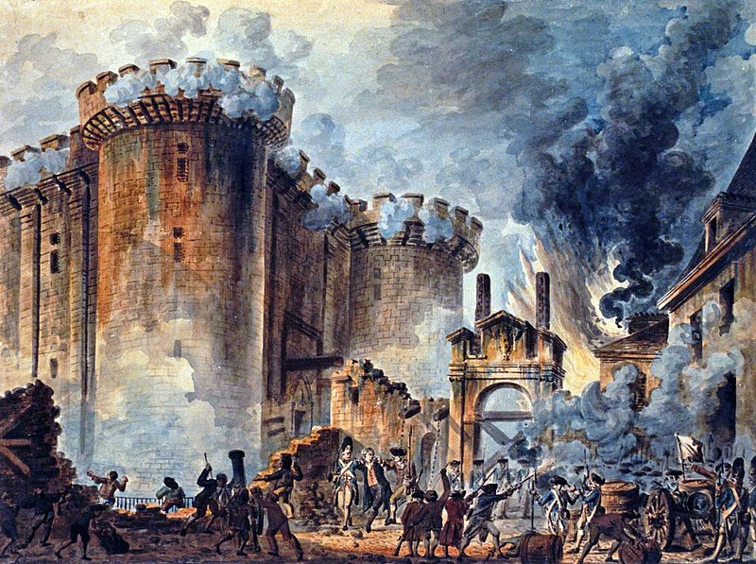

Slide 20
D. What were the French peasants reacting to in their rebellions of 1789?
Great Fear
After the storming of the Bastille, Louis XVI could no longer trust his soldiers to shoot at revolutionaries in Paris.
However, in the rest of France, the people of rural villages were getting word that foreign countries were going to send aid to put down the revolution.
In response, panic ensued, and villagers began breaking into the houses of the Lords to destroy records of their connections to the revolution.

Slide 21
The French Revolution
E. How did the French Revolution enter a new phase after the storming of the Bastille?
F. Why did the French Revolution become more radical?
G. How did the new French government deal with the crisis?

Slide 22
E. How did the French Revolution enter a new phase after the storming of the Bastille?
The National Assembly voted to abolish all privileges of the nobles and clergy.
Declaration of the Rights of Man
All men were equal and free
Prosperity should be based on talent
No group should be exempt from taxation
New government with limited power granted to the king. A Legislative Assembly would now make the laws.
Church lands were sold off to increase state revenues, and bishops/priests were now appointed and paid by the state, instead of the Pope.

Slide 23
F. Why did the French Revolution become more radical?
1792 – new National Convention elected.
Almost all of the new National Convention members distrusted the king.
September 21 – National Convention votes to abolish the monarchy and create a republic.
January 21, 1793 – Louis XVI beheaded
Not all of France was in agreement to the beheading, some peasants in rural France refused to accept authority of the Convention.
All surrounding nations set up a coalition to attack France, attempting to re-establish the old government.

Slide 24
F. Why did the French Revolution become more radical?
The Reign of Terror – occurred for approximately a year between 1793 and 1794.
Committee of Public Safety led by Robespierre
Counterrevolutionaries and traitors to the National convention were tried, convicted, and executed.
40,000 were executed, including Marie Antoinette.
16,000 by Guillotine and others by grape shot.
Good citizenship was rewarded – “citizen/citizeness”
De-Christianization was pursued, attempting to abolish “superstition” and a new calendar made Sunday worship void.

Slide 25
G. How did the new French government deal with the crisis?
The National Convention eventually became nervous of the crazed Robespierre, fearing they might be his next victims.
July 28, 1794, Robespierre was executed.
The Reign of Terror ended and it’s restrictions came to an end (churches re-opened, etc.).
1795 – New Constitution was written. The new government was corrupt and it began to depend too much upon the military (1 million strong).
1799 – General Napoleon Bonaparte topples the new government (Directory) in a coup d’etat – sudden overthrow of the government.

Slide 26
The French Revolution
H. Describe the new government established by Napoleon Bonaparte.
I. Why did changes in France’s government cause concern in other European countries?
Read pp. 163 – 167, answer questions 1, 4, 5, 6 on p. 167. We will discuss as class when finished.

Slide 27
The French Revolution
J. How did Napoleon lose his empire?
K. Why did the turmoil of the French revolutionary years result in a conservative European reaction?
L. What happened to revolutionary ideas after the French Revolution was over?
Read pp. 168 – 171, answer questions 1, 3, 4, 5, on p. 167. We will discuss as class when finished.

