Slide 1
Part 1: Napalm, Agent Orange, and Carpet Bombing W.62 Describe the Soviet-United States competition in Asia with particular attention to the Korean War and Vietnam War and describe the environmental changes due to carpet bombing, Napalm, and Agent Orange.
L) Identify carpet bombing, Napalm, and Agent Orange.
M) Describe environmental and human changes due to the effects of Napalm and Agent Orange.

Slide 2
L. Identify carpet bombing, Napalm, and Agent Orange
Carpet Bombing (Saturation Bombing): the method of provoking damage on every part of a selected area of land (in the same way carpet covers a floor).
Started in WWII
Used in Vietnam, usually to destroy large tracts of rural jungle where enemy forces may have hidden bases (usually with napalm).
Video: 16 seconds https://www.youtube.com/watch?v=sks6D2l8erA

Slide 3
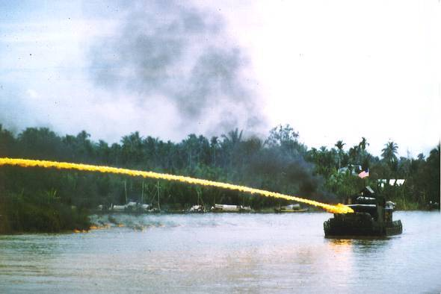
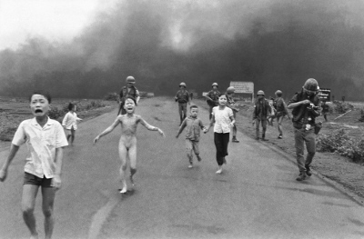
L. Identify carpet bombing, Napalm, and Agent Orange
Napalm: flammable and explosive liquid used in warfare.
Includes a sticky gel that makes it difficult to remove from surfaces, including skin.
Burns at 1,500 – 2,200 degrees F.
Used abundantly in Vietnam due to its natural effectiveness against dug in enemy personnel (Cu-Chi tunnels).

Slide 4
L. Identify carpet bombing, Napalm, and Agent Orange
Agent Orange (Herbicide Orange):
Used to kill vegetation that the Viet-Cong were hiding among (“Operation Ranch Hand”).
Over 20% of Vietnam’s jungle was sprayed, destroying over 5 million acres (nearly 8,000 square miles).
Included deadly chemical agent dioxin
http://www.nytimes.com/video/us/100000002872288/agent-orange.html

Slide 5
M) Describe environmental and human changes due to the effects of Napalm and Agent Orange.
Besides vegetation, what else was destroyed/effected by the use of napalm and agent orange?
Water Supply
Animal Population
Humans
How did the destruction of vegetation, water supply, and animal population effect the Vietnamese people (think developing nation)?
Increased difficulty in growing crops (could be impossible)
Halted fishing economy in many areas
Increased miscarriages and birth defects

Slide 6
Assessment (Quiz – separate sheet)
Describe Carpet Bombing.
Describe Napalm.
Describe Agent Orange.
How did the above three effect the environment of Vietnam (what did it destroy)?
Give examples of how the destruction had long term effects on the Vietnamese and Vietnam veterans.

Slide 7
Part 2: End of the Cold War W.79 Write an informational piece describing the weaknesses of the Soviet command economy, the burdens of Soviet life, and its eventual collapse.
N) Identify what/why: problems that emerged in the Soviet Union starting in the 1980’s.
O) Describe how Mikhail Gorbachev’s reforms changed the Soviet Union.

Slide 8
N) Identify what/why: Problems that emerged in the Soviet Union starting in the 1980’s.
By 1980, the Soviet Union was facing the following problems:
Declining economy
“They pretend to pay us and we pretend to work.”
No incentives to work
It is estimated 70% of able workers were going to military
Poor working conditions
Rise in infant mortality rate
Increased from 7/1,000 (1970) to 31/1,000 (1975)
Free healthcare was a bright spot, but doctors also had no incentive.

Slide 9
N) Identify what/why: Problems that emerged in the Soviet Union starting in the 1980’s.
Alcoholism
Estimated that at least 20% of men in the U.S.S.R. were alcoholics.
Alcohol was a source of state revenue (taxes) and many leaders turned a blind eye to it for many reasons.
Gorbachev’s Anti-Alcohol Campaign (1985) – objective O
Afterwards, spending on alcohol fell billions of rubles by 1987, and the expected 10% increase in worker productivity never came to fruition.
Ultimately, mortality rates increased throughout the 1980’s.

Slide 10
O) Describe how Mikhail Gorbachev’s reforms changed the Soviet Union.
When Mikhail Gorbachev took office in 1985, he knew political reforms needed to be put in place.
His series of political reforms were known as perestroika, or restructuring which included:
A shift to a market economy more responsive to consumers
Glasnot – policy of political openness used to discuss the strengths and weaknesses of the Soviet government.

Slide 11
N) Identify what/why: Problems that emerged in the Soviet Union starting in the 1980’s.
By 1989, a parliament of elected officials had been established and named himself “president”.
In 1987, Gorbachev and President Ronald Reagan agreed Intermediate-Range INF Treaty to eliminate intermediate range nuclear weapons (to fix internal economic problems for both).

Slide 12
N) Identify what/why: Problems that emerged in the Soviet Union starting in the 1980’s.
By 1989, Soviet military presence in communist Eastern European countries was halted, leading to independence movements in those countries.
October 1990, Germany was reunified.
In 1991, the Soviet Union was dissolved (Russia, Ukraine, Belarus, Georgia, Armenia, Azerbaijan became independent of one another).

Slide 13
Assessment
Write a 5 paragraph essay describing the weaknesses of the Soviet command economy, the burdens of Soviet life, and its eventual collapse.
In other words, answer the following:
Paragraph 2: What problems (3) existed in 1980’s Soviet Union?
Paragraph 3: What policies did Mikhail Gorbachev implement to solve those problems?
Paragraph 4: How did that lead to the dissolving of the Soviet Union?
Paragraph 1: Intro
Paragraph 5: Conclusion
Due Friday, May 1

